Slide 1
Simple Interest
Minimum Monthly and Minimum Daily

Slide 2
SIMPLE Interest
I = interest
P = principal
R = rate (%)
T = time
I = PRT

Slide 3
Minimum monthly balance

Slide 5
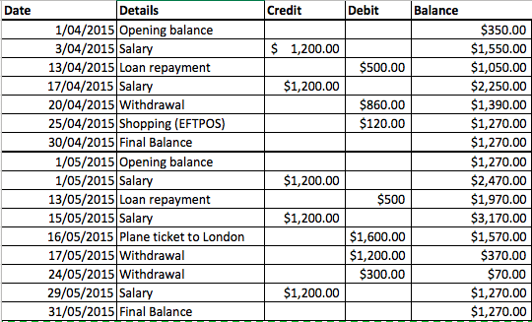

Slide 6
Minimum DAILY balance

Slide 7
$350 | $1,550 | $1,050 | $2,250 | $1,390 | $1,270
2 days| 10 days | 4 days | 3 days | 5 days | 6 days

